Slide 1
Amazon DynamoDB

Slide 2
Anatomy of an Item
An item is the core unit of data in DynamoDB.
It is comparable to a row in a relational database, a document in MongoDB, or a simple object in a programming language.
Each item is uniquely identifiable by a primary key that is set on a table level.
An item is composed of attributes, which are bits of data on the item. This could be the "Name" for a User, or the "Year" for a Car.
Attributes have types -- e.g., strings, numbers, lists, sets, etc -- which must be provided when writing and querying Items.

Slide 3
Amazon DynamoDB
Amazon DynamoDB is a key-value and document database that delivers single-digit millisecond performance at any scale.
It's a fully managed, multi-region, multi-active, durable database with built-in security, backup and restore, and in-memory caching for internet-scale applications.
DynamoDB can handle more than 10 trillion requests per day and can support peaks of more than 20 million requests per second.

Slide 4
Keys
When creating a new table, you will need to specify the primary key of that table.
Every item in a table is uniquely identified by its primary key.
Accordingly, the primary key must be included with every item that is written to a DynamoDB table.
There are two types of primary keys.
A simple primary key uses a single attribute to identify an item, such as a Username or an OrderId.
Using a DynamoDB table with a simple primary key is similar to using most simple key-value stores, such as Memcached.
A composite primary key uses a combination of two attributes to identify a particular item.
The first attribute is a partition key (also known as a "hash key") which is used to segment and distribute items across shards.

Slide 5
Attributes
An item is made up of attributes, which are different elements of data on a particular item.
For example, an item in the User table might have a Name attribute, an Age attribute, an Address attribute, and more.
They are comparable to columns in a relational database.

Slide 6
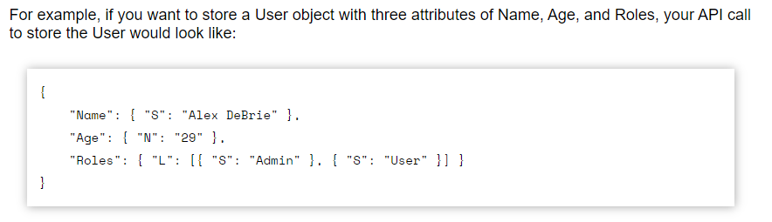
Attribute types
When setting an attribute for a DynamoDB item, you must specify the type of the attribute.
Available types include simple types like strings and numbers as well as composite types like lists, maps, or sets.

Slide 7
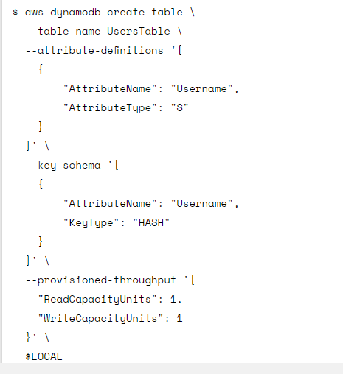
Creating a table

Slide 8
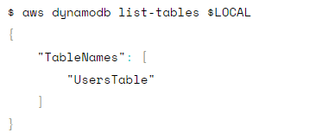

Creating a table

Slide 9
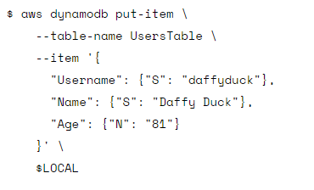
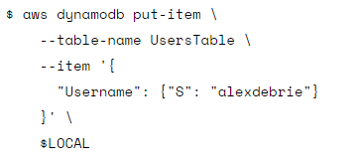
Put Item

Slide 10
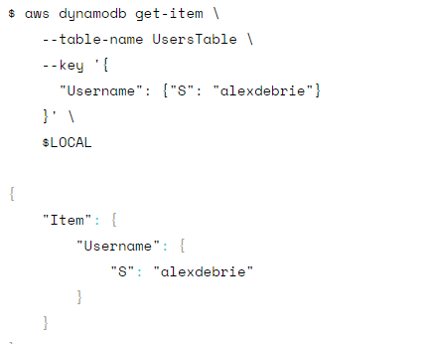
Get Item

Slide 11
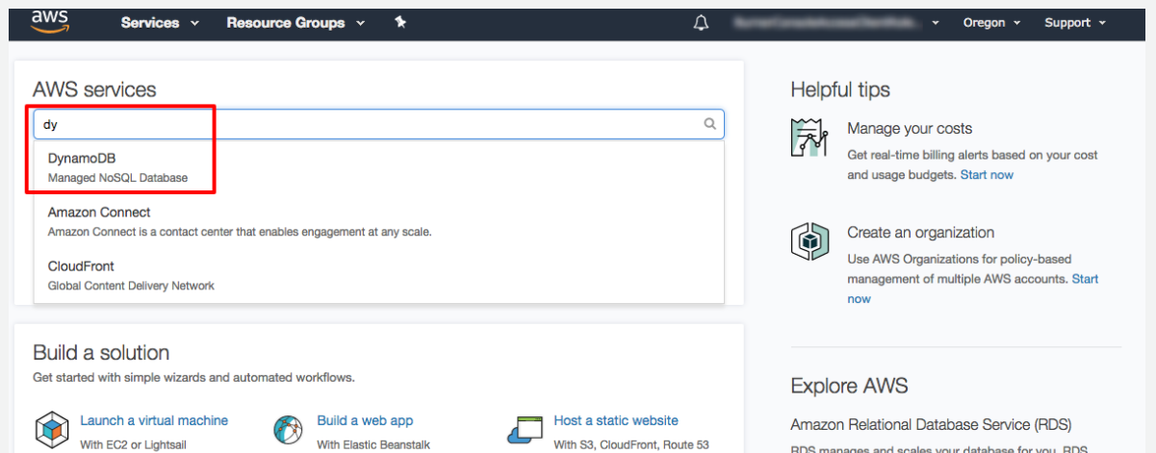

Slide 12
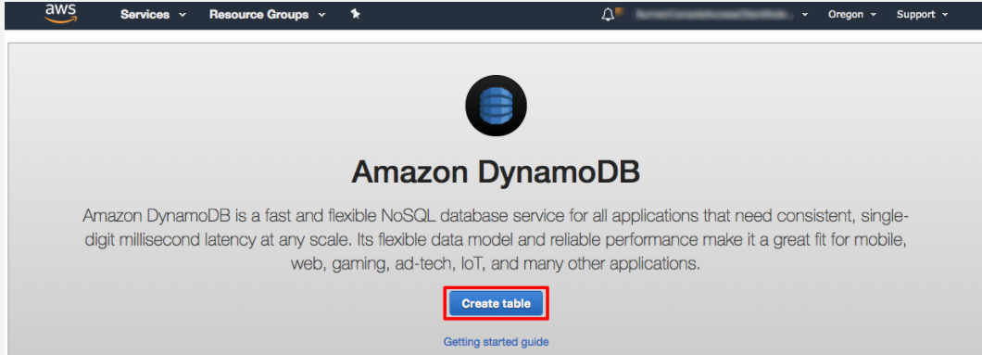
DynamoDB console to create a table.

Slide 13
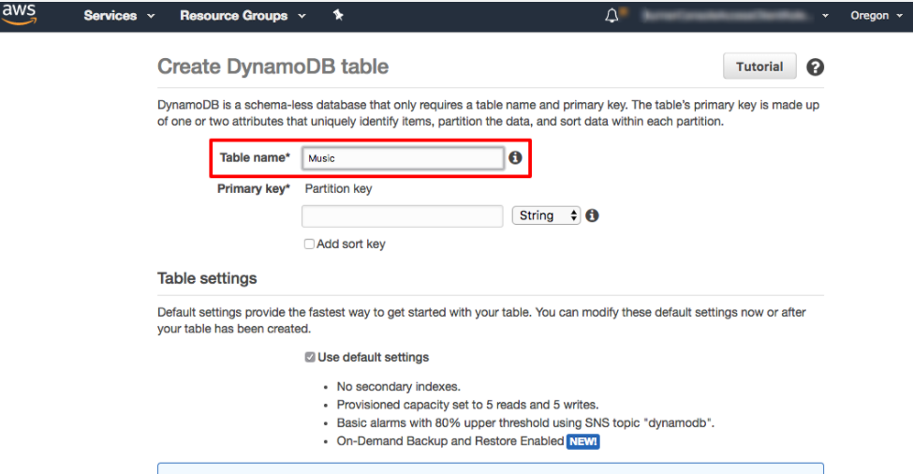
DynamoDB console to create a table.

Slide 14
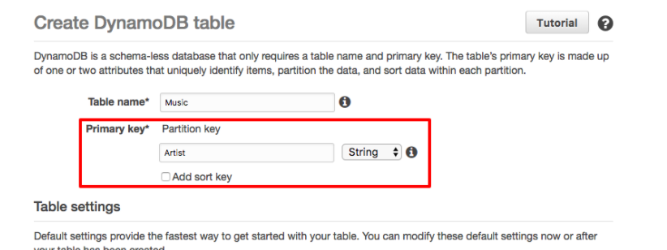
The partition key is used to spread data across partitions for scalability. It’s important to choose an attribute with a wide range of values and that is likely to have evenly distributed access patterns.

Slide 15
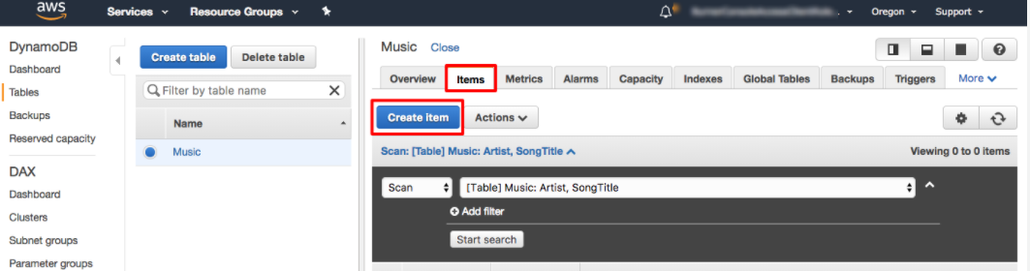
add data to your new DynamoDB table.

Slide 16
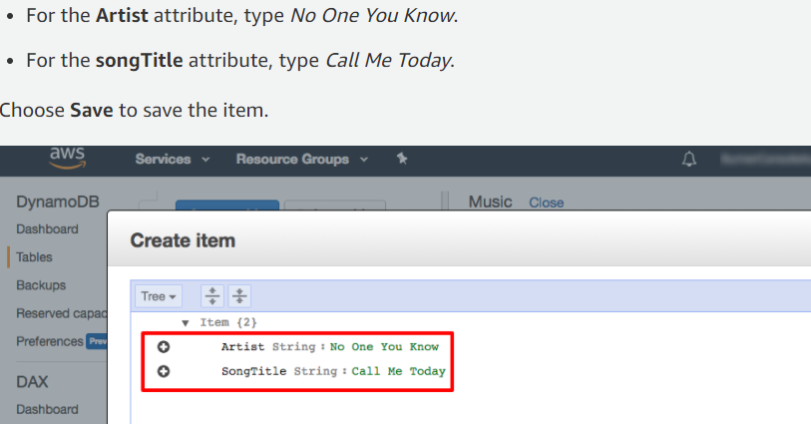
add data to your new DynamoDB table.

Slide 17
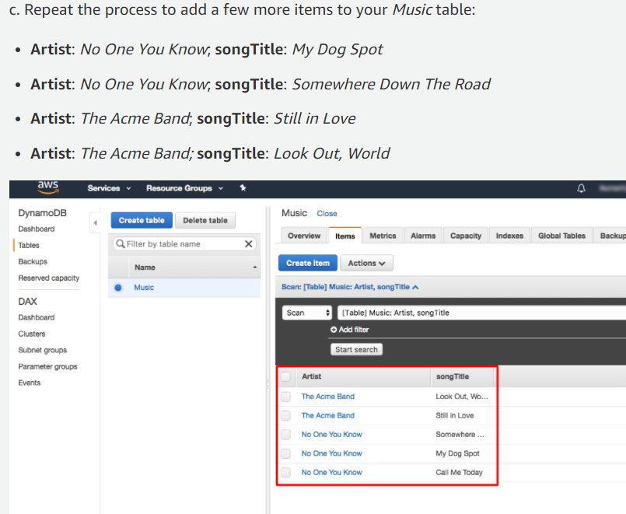
add data to your new DynamoDB table.

Slide 18
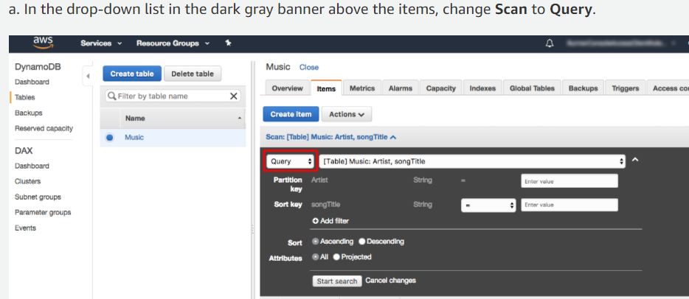
table using query operations

Slide 19
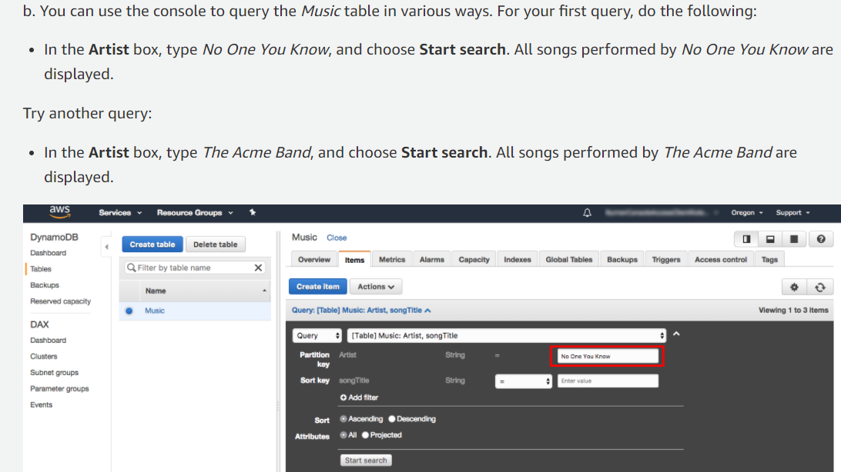
table using query operations

Slide 20
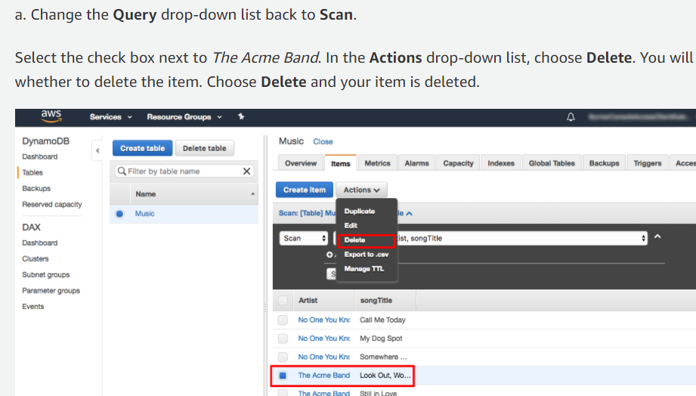
delete an item from DynamoDB table

Slide 21
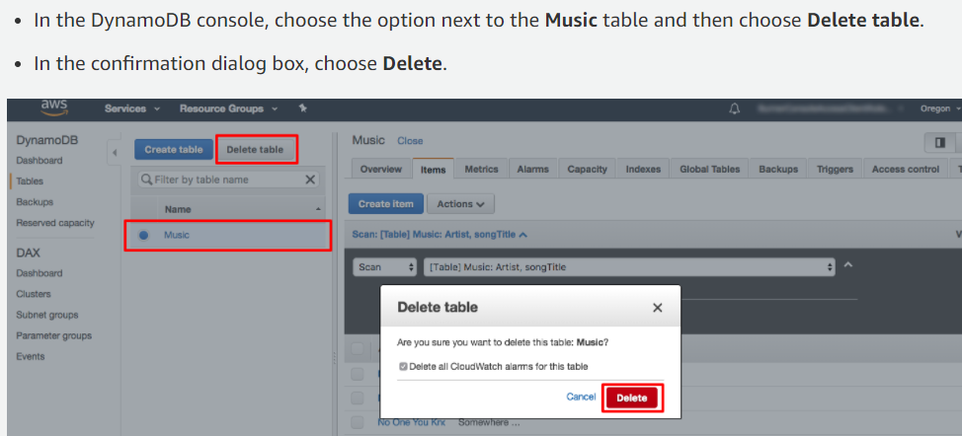
Delete DynamoDB table

Slide 22
Spring Boot REST Application with Dynamo Db
Add dependency in pom.xml as maven project:
<dependency>
<groupId>com.amazonaws</groupId>
<artifactId>aws-java-sdk-dynamodb</artifactId>
<version>1.11.815</version>
</dependency>

Slide 23
Get Credentials Information
Goto IAM --> User --> Security Credentials --> Access Key --> Create Access key --> download key (from the csv file collect Access & Secret Key )
Those are required in SpringBoot's DbConfig class , as well as required :
Region code
Service End point

Slide 24
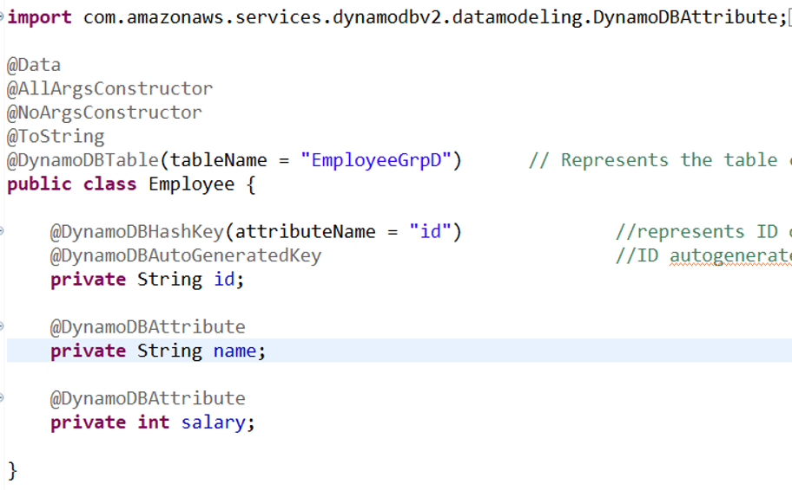
Spring Boot REST Application with Dynamo Db
Entity Class:

Slide 25
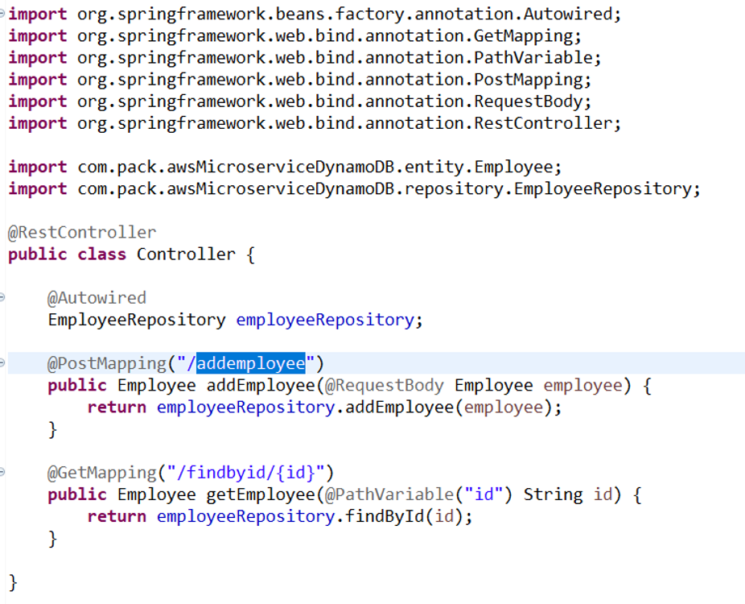
Spring Boot REST Application with Dynamo Db
Controller class:

Slide 26
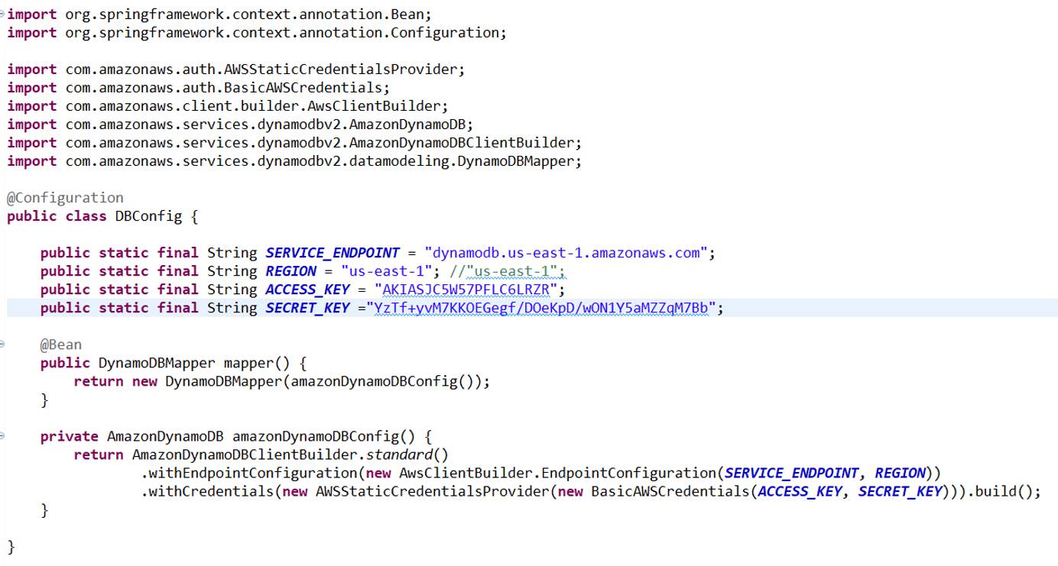
Spring Boot REST Application with Dynamo Db
Configuration class:

